Slide 1
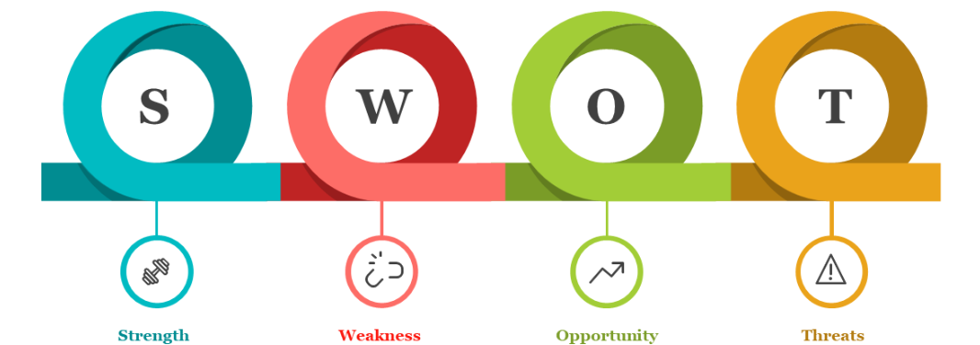

ANALYSIS
NAME = Satya Kumar Chaudhary
REGISTRATION NUMBER = 12203506
DOMAIN = CSE
SECTION = K22AE

Slide 2

STRENGTHS
EXTROVERT
Modern Tech. Knowledge
Gets Mix up With New People Easily

Slide 3

WEAKNESS
Emotional personality
lack of English fluency
laziness
ACTION PLAN
I have been improving my English fluency while communicating with my friends
I have been doing daily exercises, improving my sleep schedule to improve my personality
Anger issues

Slide 4

OPPORTUNITIES
Internship
Earning various certifications
Following my passion for CSE

Slide 5

THREATS
Competition With Piers
Changing Trends Of Technology

Slide 6
THANK YOU

